Slide 1
Commonwealth of Puerto Rico
Governor’s Federal Grants & Contracts Training Summit
Ripple Effect: How the Federal Government’s Financial Position Affects the States and Territories
Presented By
Edward J. Mazur
Senior Advisor for Public Sector Services
CliftonLarsonAllen LLP
February 4, 2015

Slide 2
Session Learning Objectives
To Gain an Understanding of:
The Financial Condition of the U.S. Government
Key Measures of Intergovernmental Financial Dependency (IFD)for the States and Territories
The Implications of IFD for Puerto Rico
Options Open in Responding to IFD Risks

Slide 3
Key Assertions
The fiscal condition of the U.S. Government is not sustainable
The financial dependence of states, local governments, and territories on the federal government is material and wide-spread
Unplanned disruptions of federal flows are occurring and will increase
Reducing federal expenditures through across the board cuts (i.e. sequester provisions) harms essential programs and sustains low priority programs

Slide 4
Published Reports on the Impact of IFD in Puerto Rico
April 29, 2014, Reuters Headline: “Puerto Rico Governor to announce billion-dollar budget cut”
Governor Alejandro Garcia Padilla, who will reveal his plan in an address the legislature, has said “everything is on the table except firing public employees. Officials have said a 10 percent across-the-board cut in government agencies is coming.”
House Treasury Committee Chairman Rafael Hernández Montañez states, “the commonwealth government would no longer provide subsidies to public corporations, and that new legislation would order their directors to become financially self-sufficient, including renegotiating with contracted suppliers and employees.”

Slide 5
Published Reports on the Impact of IFD (cont’d)
July 1, 2014, Reuters Headline: “Puerto Rico governor signs $9.56 billion budget for 2015”
“Puerto Rico Governor Alejandro Garcia Padilla on Tuesday signed a $9.56 billion budget for 2015, a blueprint that cuts spending by $200 million from the previous year amid a continued contraction in the island's economy.”
“As part of the budget process, the governor pushed through a fiscal emergency law that freezes salaries and cuts other benefits for employees across government agencies and public corporations. Other savings are slated to be achieved by consolidating 25 government entities, closing more than 80 schools and putting towns in charge of providing school transportation”

Slide 6
Published Reports on the Impact of IFD (cont’d)
January 22, 2015, Latin American Herald Tribune Headline: “U.S. Budget Cuts Could Cost Puerto Rico $200 Million”
“Puerto Rico will lose some 10 percent of federal funds that had been
allocated to the island up to September as a result of the $38-billion reduction in government spending agreed by the U.S. Congress.”

Slide 7
Published Reports on Impact of IFD in Virginia
August 16, 2014 RTD* Headline: “$346 in new cuts await Va.”
“Faced with a $2.4 billion revenue shortfall in the current two-year state budget, Gov. Terry McAuliffe is calling for $346 million in spending cuts this year and a new economic strategy to deal with declining U.S. defense spending in Virginia.”
Oct. 16th RTD Headline: “State to Cut 565 Jobs”
“In the midst of uncertainty in Washington over sequestration and the federal budget, we have an obligation to prepare Virginia as much as possible for the reduction of federal spending that we all know is coming.” Gov. McAuliffe
*Richmond Times-Dispatch

Slide 8
Published Reports on Impact of IFD (cont’d)
November 30, 2014 RDT Sec. A: “Washington region suffering effects of U.S. spending cuts”
“The Washington area’s reliance on federal spending has become a major headache for state and local governments, with congressionally mandated cuts leaving gapping holes in revenue projections from Annapolis, Md., to Richmond.”
September 27, 2014 RDT Headline: “VSU students, faculty anxious about cuts”
Fall enrollment drops by 1,000, with loss of $17.6 million in revenue. “…budget problems are the result of changes in federal financial aid policies…”
October 31, 2014, RTD: “VSU President Keith Miller to step down Dec. 31”

Slide 9
The Fiscal Condition of the U.S. Government
Notes:
The U.S. Treasury Department and the U.S. Comptroller General have declared the Federal Government to be fiscally unsustainable.
Both Social Security and Medicare programs currently disburse more then they take in and therefore are drawing down on their trust fund balances.
Sequester provisions and other cuts called for in the Budget Control Act of 2011 are beginning to reduce Federal discretionary programs, and are scheduled to total$2.1 Trillion over ten years.

Slide 10
Concerns About Federal Fiscal Sustainability
U.S. Treasury Department and the Comptroller General declared the Federal Government fiscally unsustainable
The Federal Reserve now holds $4.5 trillion in mortgage-backed and Treasury securities purchased by creating (i.e. printing) money
Both Social Security and Medicare programs are drawing down on their trust fund balances. DI program reserves will be depleted in 2016, reducing benefits by 20%. HI reserves will be depleted in 2026
“Between 2009 and 2012, the federal government recorded the largest budget deficits relative to the size of the economy since 1946, causing federal debt to soar,” says the CBO
Notes:
The 2012 Financial Report of the United States Government states, “The projections in this Report indicate that current policy is not sustainable. The debt-to-GDP ratio is projected to reach 395 percent in 2087 and to rise continuously thereafter. Preventing the debt-to-GDP ratio from rising over the next 75 years is estimated to require some combination of spending reductions and revenue increases that amount to 2.7 percent of GDP over the period. While this estimate of the “75-year fiscal gap” is highly uncertain, current fiscal policies cannot be sustained indefinitely.”
Through its quantitative easing program, the Federal Reserve is creating (i.e. printing) money and buying $40 billion of mortgage-backed securities and $45 billion of U.S. Treasuries per month—Federal Reserve will end quantitative easing program that has seen it spend billions on bonds over past six years; will continue to hold short-term interest rates near zero, and will replace maturing bonds to keep holdings at about $4.5 trillion Under QE, the Fed bought its trillions of dollars-worth of bonds mostly from banks and paid the banks by depositing the money in their accounts at the Federal Reserve. Banks were then free to lend the money, but Blinder says even as those trillions piled up, banks decided not to lend most of it
The statement of the Comptroller General of the United States included in this report stated, “The comprehensive long-term fiscal projections presented in the unaudited Required Supplemental Information section of the 2012 Financial Report of the United States of the United States Government show that—absent policy changes—the federal government continues to face an unsustainable fiscal path.”

Slide 11
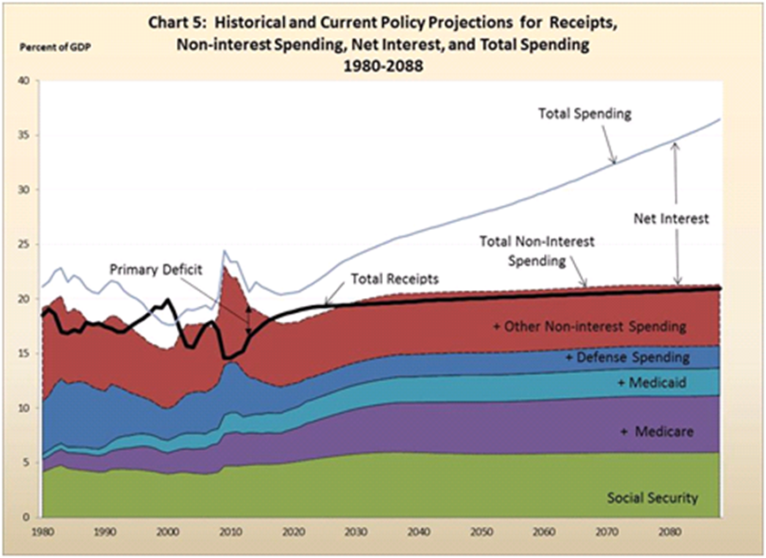
Source: A Citizen’s Guide to the 2013 Financial Report of the U.S. Government

Slide 12
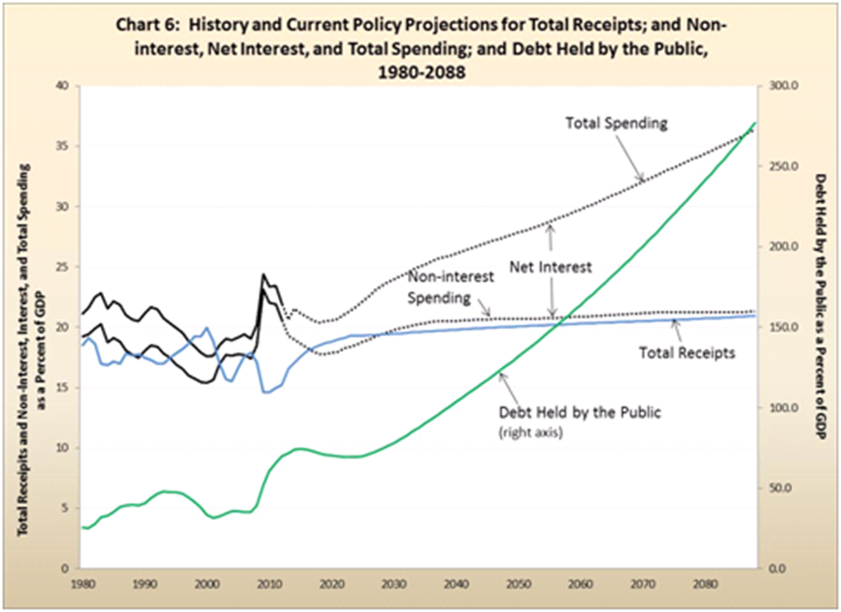
* 2014
Source: A Citizen’s Guide to the 2013 Financial Report of the U.S. Government
Notes:
Continued negative projections by CBO and GAO on the long-term fiscal condition of the federal government
Continued negative disclosures concerning long-term fiscal sustainability reported in annual “Financial Report of the United States Government”
Continued negative projections by Trustees of Social Security and Medicare funds
Assignment of lower ratings or negative watch notices on bonds of states and localities identified as being susceptible to changes in federal flows
Continued AA+ rating from S & P on U.S. Treasury Securities, which S & P reported on August 5, 2011:
“…reflects our view that the effectiveness, stability, and predictability of American policymaking and political institutions have weakened at a time of ongoing fiscal challenges…”

Slide 13
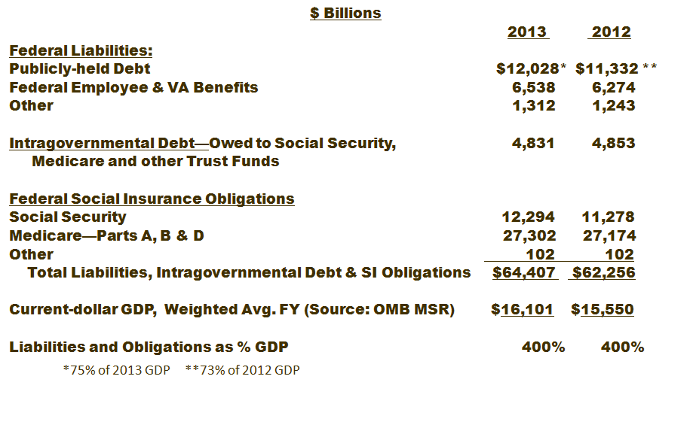
Analysis of Federal Liabilities, Intragovernmental Debt, and Social Insurance Obligations
Source of Financial Statement Data: 2013 Financial Report of U.S. Government
Notes:
Note: total liabilities, intragovernmental debt and SI obligations presented above are $62,256 billion, or $62.3 trillion. As a means of articulating how immense this number in contrast to the total resources of the nation, one can cite that the Federal Reserves number for Household and Nonprofit Organization Net Worth for the third quarter of 2012 is only: $64,769 billion, or $64.8 trillion, as noted at: http://www.federalreserve.gov/releases/Z1/Current/accessible/b100.htm. See the 9th line up from the bottom of the table.
Total Liabilities, Intergovernmental Debt, and SI Obligations of $62.3 trillion equates to represent 96% of total household and nonprofit net worth of $64.8 trillion.
Re: GDP, per Scott Bell: Table 2 in OMB's Midsession Review (MSR) to the 2013 budget (http://www.whitehouse.gov/sites/default/files/omb/budget/fy2013/assets/13msr.pdf ) shows the economic assumptions used in the MSR, including GDP. In Table 2, 2012 GDP (current dollars) is 15,702 – which, when used as the denominator, results in a 71.9% ratio. However, this is a calendar year figure, so taking a weighted average of 75% of this amount and 25% of the FY 2011 (15,094) equals a weighted average (fiscal year amount) of 15,550 - - which yields a ratio of 72.7% - round to 73%. The 2012 amount in the MSR is projected, but this should still give you a reasonable proxy for your calculations. That said, you get the same result when you apply the current dollar GDP growth rate cited in the BEA report of 4.0% to the actual 2011 GDP in the MSR (15094).

Slide 14
Indicators of Further Deterioration in the Fiscal Condition of the Federal Government
Continued negative projections by CBO and GAO on the long-term fiscal condition of the federal government
Continued negative disclosures concerning long-term fiscal sustainability reported in annual “Financial Report of the United States Government”
Continued negative projections by Trustees of Social Security and Medicare funds
Assignment of lower ratings or negative watch notices on bonds of states and localities identified as being susceptible to changes in federal flows
Continued AA+ rating from S & P on U.S. Treasury Securities, which S & P reported on August 5, 2011:
  “…reflects our view that the effectiveness, stability, and predictability of American policymaking and political institutions have weakened at a time of ongoing fiscal challenges…”
Notes:
GAO--the state and local sector will provide an additional drag on an already declining federal government fiscal outlook and that the critical problem of escalating costs of health care is an economy wide problem that will need to be addressed by all levels of government. For access to the April 2012 State and Local Governments’ Fiscal Outlook report (the latest available) go to: http://www.gao.gov/search?q=State+and+Local+Governments%27+Fiscal+Outlook&Submit=SearchJuly 13, 2011 Moody’s placed the U.S. government’s debt rating on review for possible downgrade
State Rating Changes Through the Recession---Rating Actions
2007-2012 Upgrades 8, downgrades 18, negative outlook changes 34
Currently, Moody’s : 40 Stable outlooks, 10 Negative outlooks, 0 Positive outlooks
AAA states governments remain negative due to high dependency on federal employment and federal spending—Maryland, Virginia, and New Mexico
Fitch:
Affected bonds include the following issuances or programs:
--Hawaii Housing Finance & Development Corp. (HI) / 1980 Indenture - SF Mortgages;
--Indiana Housing and Community Development Authority (IN)/June 1980 Indenture - SF Mortgages;
--New Florence Nursing Home, Inc. (MO)/GNMA MBS;

Slide 15

Key Measures of Intergovernmental Financial Dependency

Slide 16
What is Intergovernmental Financial Dependency?
  The transfer of significant amounts of financial resources among the three levels of government in the U.S., and
  The direct operating activities of one level of government occurring within the communities of another level of government
Paraphrased from the “Intergovernmental Financial Dependency Risk Prospectus,” presented to the Government Accounting Standards Board by GASB staff, dated March 19, 2007.

Slide 17
Key Dependency Measures—
Maryland, Puerto Rico, and Total U.S. ($ in Billions)
Key Dependency Measurement | MD 2012 | PR 2012 | Total U.S. 2012
Direct Federal Revenues to State | $12.8 | $6.7 | $702.4
Percentage of Total State Revenues – All Sources | 32.7% | 21.6% | 35.0%*
Direct Federal Grants to Local Governments (2011) | $1.5 | $0.4 | $68.4
Federal Purchases from State Businesses | $27.3 | $0.7 | $437.2
Federal Payments to Individuals (2010 & 2012) – Wages, Pensions, Social Security, Medicare | $51.6 | $12.8 | $1,877.8
Total Direct and Indirect Federal Flows | $93.2 | $16.4 | $3,085.8
* Average
Notes:
Primary Source: 2013 edition, “Intergovernmental Financial Dependency: A Study of Key Measure of Dependency for the 50 States.” Sources of data used in that report consist of state CAFRs, state Single Audit Reports,

Slide 18
Key Dependency Measures—
Maryland, Puerto Rico, and Total U.S. ($ in Billions)
Key Dependency Measurement | MD 2012 | PR 2012 | Total U.S. 2012
Total Direct and Indirect Federal Flows | $93.2 | $16.4 | $3,085.8
Real GDP by State Inflation Adjusted to 2005~ | $274.9 | $101.1 | $13,337.6
Total Federal Flows Gross State Product | 33.9% | 16.2% | $25.6%*
Military Facilities- Count | 121 | 37 | 4,343
Military Facilities- Present Replacement Value | $21.8 | $3.2 | $663.3
Military Facilities – Military and Civilian Personnel (thousands) | 95.4 | 15.7 | 2,728
Federal Leased/Owned Buildings (millions sq/ft) (2012) | 29.2 | 1.7 | 303.4
* Average of individual state percentages
~ Source: BEA, obtained Jan. 2014
Notes:
The 1.7 million ft2 for PR is as of January 2015.

Slide 19
Key Dependency Measures:
States By Percentage of Revenue—2012 ($ Billions)
State (Top 5) | Direct Federal Revenues to State | Percentage of Total State Revenues- All Sources
1- Rhode Island | $4.9 | 56.6%
2- South Dakota | $2.5 | 53.9%
3- Tennessee | $19.3 | 53.6%
4- Louisiana | $15.8 | 48.9%
5- Arkansas | $8.7 | 45.5%
State (Median)
25- Wisconsin | $12.9 | 34.7%
26- Ohio | $24.7 | 34.1%
State (Lowest)
50- Wyoming | $1.0 | 14.8%
Average 50 States = 35.0%

Slide 20
Key Dependency Measures:
States By Percentage of GDP—2012 ($ Billions)
State (Top 5) | Total Direct & Indirect Federal Revenues to State | Percentage of Total State GDP
1- Mississippi | $35.3 | 40.8%
2- Kentucky | $55.6 | 37.9%
3- West Virginia | $21.3 | 37.9%
4- Alabama | $56.6 | 36.0%
5- New Mexico | $25.1 | 35.5%
State (Median)
25- Georgia | $92.7 | 24.8%
26- North Dakota | $9.3 | 24.1%
State (Lowest)
50- Delaware | $8.3 | 14.8%
Average 50 States = 25.6%

Slide 21
Key Dependency Measures:
Top 5 States Per Category—2012
State | Military Facilities
1- California | 349
2- Montana | 253
3- Virginia | 222
4- Florida | 219
5- Texas | 204
State | Military Personnel
1- California | 288,100
2- Virginia | 237,700
3- Texas | 235,900
4- North Carolina | 159,200
5- Georgia | 137,600
State | Federal Leased/Owned Buildings (Million Sq. ft)
1- Maryland | 29.2
2- Virginia | 27.4
3- California | 26.9
4- Texas | 22.4
5- Missouri | 17.0

Slide 22
Risks to States, Local Governments, and Territories From Intergovernmental Financial Dependency
Significant future fluctuations in :
  direct intergovernmental revenue flows,
  indirect flows which impact economic activity and tax revenues, and
  income and asset values associated with U.S. Treasury Securities
  Evidence:
  October 2013, 16 day shutdown of portions of the Federal Government and its impact on individuals and the economy
  Budget Control Act, August 2011, which reduced federal expenditures by $2.1 trillion over ten years
  Impact of sequester reductions in 2013 and 2014
Notes:
Potential fluctuations to, considering changes in:
Federal Reserve policy and
Levels of holdings by foreign governments!

Slide 23
Estimating IFD Impact on Local Governments
An Illustrative Example—
Prince William County, Virginia

Slide 24
Key Dependency Measures
Prince William County, Virginia ($ in Millions)
Key Dependency Measurement | Total 2011
Direct Federal Revenues to County | $136.7
Direct Commonwealth Revenues to County | 486.1
Total Federal and Commonwealth Revenues to County | $622.8
Percentage of Total County Revenues – All Sources* | 32.1%
Federal Purchases from County Businesses (2010) | $2,373.5
Federal Payments to Individuals (2010) – Wages, Pensions, Social Security, Medicare | $1,902.0
Total Direct Federal and Commonwealth Flows and Indirect Federal Flows | $4,898.3
* $1,941.2 million
Notes:
Sources:
¹ Direct Federal Revenues to Entity: Data Collection Forms, FY2011
² Total Entity Revenue: The Entity's FY2011 Consolidation Annual Financial Report (CAFR), Government -Wide Financial Statements, Statement of Activities
³ Direct Revenue from the Commonwealth: VA Auditor of Public Accounts Comparative Report of the Local Governments Revenue and Expenditures, FY2011
⁴ Federal Grants to Local Governments: 2010 Annual Survey of State and Local Government Finances, Governments Division, U.S. Census Bureau
⁵ Federal Purchases from State Businesses (Prince William County): 2010 Consolidated Federal Funds Report, Governments Division, U.S. Census Bureau
⁵ Federal Purchases from State Businesses (VA and US): 'Trends' function on www.USAspending.gov for FY11 - Contracts
⁶ Federal Payments to Individuals – Wages, Pensions, Social Security, Medicare: 2010 Consolidated Federal Funds Report, Governments Division, U.S. Census Bureau
⁷ Real GDP: 2011 Real Gross Domestic Product by State, U.S. Bureau of Economic Analysis, obtained Dec. 2012
⁸ Military Facilities: Department of Defense '2012 Base Structure Report' illustrating Total DoD Inventory as of 9-30-11
⁹ Federal Leased/Owned Buildings: U.S. General Services Administration, Inventory of Leased and Owned Buildings, Dec. 6, 2012 (for VA and US) & Dec. 18, 2012 (for Pr. William County)
*Military Facilities (Pr. William County): Fort Belvoir and MCB Quantico were chosen based on proximity to Prince William's County.

Slide 25
Additional Key Dependency Measures
Prince William County, Virginia
Key Dependency Measurement | County 2011
Military Facilities- Count | 2*
Military Facilities- Present Replacement Value ($Billions) | $6.8*
Military Facilities – Military and Civilian Personnel | 321,668**
Federal Leased/Owned Buildings (millions sq/ft) (2012) | .2
*Fort Belvoir and MCB Quantico based on proximity to County
** Ft. Belvoir-35,330, Quantico-286,338 Note: Quantico may include deployed military. Ref. DOD Base Structure Report FY 2012
Notes:
DEPARTMENT OF DEFENSE BASE STRUCTURE REPORT FISCAL YEAR 2012 BASELINE
OFFICE OF THE DEPUTY UNDER SECRETARY OF DEFENSE (INSTALLATIONS & ENVIRONMENT)

Slide 26
Possible Leading Indicators of Changes in Federal and State Direct and Indirect Flows Impacting Prince William County
Direct Federal and State Flows Impacting County Revenues:
Revised federal agency budgets impacting specific education, social services, and other grants to County
Revised Commonwealth financial support for County education and other programs
Indirect Flows Impacting County Economy and Tax Revenues:
Changes in levels of federal leased property in Northern Virginia
Revised federal transportation funds flowing to Commonwealth and revised VDOT allocations of new construction and maintenance funds to County roads
Changes in headcount of military and civilian employees at area military facilities

Slide 27
Possible Leading Indicators of Changes in Federal and State Direct and Indirect Flows Impacting Prince William County (cont’d)
Indirect Flows Impacting County Economy and Tax Revenues (cont’d):
Changes in federal purchase orders received by County businesses identified as significant federal vendors
Changes in unemployment benefits to County residents
Reductions in SBA guaranteed loans provided County businesses
Changes in residential rental property vacancy rates
Changes in commercial leased property vacancy rates
Changes in K-12 enrollment levels
Reductions in Pell Grants received by County college students
Changes in nearby university and community college enrollment levels
Revised federal administrative regulations

Slide 28
Possible IFD Impact on Specific PW Revenues
General Fund Revenue
Real Estate Taxes—long term
Personal Property—medium term
Local Sales Tax—short term
Sales Tax On Daily Rental—short term
Telecommunications Sales & Use Tax—medium term
BPOL Taxes - Local Businesses—medium term
Motor Vehicles – Regular—medium term
Transient Occupancy Tax—short term
State Revenue—short term
Federal Revenue—short term
Notes:
The 2001-2004 Plan added a vision statement and modified the mission statement:
Prince William County is a premier community where we treasure our past and the promise of our future. We are
diverse and dynamic, with a thriving economy where citizens and businesses grow and succeed together. We are a
global technology leader for the 21st century.
The mission of PWC Government is to provide the necessary services to protect the health, safety, welfare, cultural
resources and environment of citizens and businesses consistent with the community’s values, priorities and fiscal
capacity. This mission is accomplished by encouraging citizen input and involvement, preserving the County’s
fiscal stability, producing effective and efficient government programs, managing the County’s resources, planning
for the future, and representing citizens’ needs and desires to other levels of government.
Economic Development - The County will provide a robust, diverse economy with more quality jobs and an
expanded commercial tax base.
▪ By 2016 the total at-place employment will increase from 111,000 to 118,000.
▪ By 2016 the cumulative number of new targeted jobs associated with new County businesses will be 1,200.
▪ By 2016 the cumulative number of new targeted jobs associated with existing County businesses will be 480.
▪ By 2016 the cumulative value of capital investment associated with new and expansion projects will be $800,000,000.
▪ By 2016 the cumulative value of capital investment in targeted redevelopment areas will be $8,000,000.
By 2016 the number of dual enrollment (PWCS/NVCC) students will increase to more than the baseline of 301.
▪ By 2016 the ratio of National Board Certified Teachers to students will increase from 1:701 to 1:500.
▪ By 2016 the percentage of accredited schools will be 100%, even with changes in the accreditation standards.
▪ By 2016 the average elementary school classroom size will decrease to less than the baseline of 23.2 students per
classroom.
▪ By 2016 the average middle school classroom size will decrease to less than the baseline of 30.7 students per
classroom.
▪ By 2016 the average high school classroom size will decrease to less than the baseline of 29.7 students per

Slide 29
Possible IFD Impact on Specific PW Revenues (cont’d)
Agency Revenue
Community Services—short term
Criminal Justice Services—short term
Fire and Rescue—short term
Police—short term
Public Safety Communications—short term
Social Services—short term
Notes:
Agency Revenue (10.9%) contains revenues
that are collected by individual County agencies. These revenues most typically come from Federal and State grants
as well as private sector sources.

Slide 30

Responding to Current IFD Risks
States, Local Governments, and Territories
Can Make a Choice When
Facing Federal Cuts and Program Changes
* * * * *
Become Informed and Proactive
OR
Be Reactive?

Slide 31
Suggested Initiatives by Elected Officials
Assign responsibility to track changes in:
  Intergovernmental flows, and underlying causes,
  Associated implementing administrative regulations
Prepare for impact of changes in intergovernmental flows
  Quantify impact of changes and update revenue and budget forecasts
  Modify strategic plans, including service capacity and performance goals
Identify and initiate active communications with those responsible for changes in intergovernmental flows (e.g. Members of the U.S. House and Senate)

Slide 32
Suggested Initiatives by S & L Elected Officials (cont’d)
4. Report impact of changes in intergovernmental flows to government stakeholders
  Continuously survey citizen reliance on government services and, concurrently, provide facts on citizen usage and intersection with services
  Disclose intergovernmental dependency in government financial reports
5. Work for change in underlying causes
  Recommend options for rebalancing federal expenditures and revenues
  Restore severed lines of Congressional responsibility, perhaps by seeking state endorsement of a constitutional convention adopting a balanced budget amendment for the U.S. Government
Notes:
Rational for Reporting Fiscal Sustainability and Intergovernmental Financial Dependency:
1. Fulfills professional and stewardship responsibilities that apply to senior government financial executives
2. Informs stakeholders of risk prior to actual reductions in federal spending (although that ship has sailed)
3. Facilitates timely and constructive actions by Governors, Legislators, and other elected officials
Alerts citizens, employees, students, local governments and others likely to be impacted by federal cuts
Moody’s published recognition, in September 2011, applauding the Commonwealth of Virginia for having created a reserve fund to mitigate susceptibility to federal revenues*
To be funded at $30 million
So that funds would be available to
continue programs affected by federal cuts,
help cover unfunded federal mandates
replace lost revenue from lower corporate taxes owing to defense or procurement cuts
*States Prepare for Federal Cuts, AGA PDC, July 2012 Emily Raimes, V.P-Senior Credit Officer
A More Perfect Constitution, Larry Sabato, p. 56 “Activism for a BBA nearly led to the calling of a second Constitutional Convention during the 1990’s when as many as thirty-two states—just two short of the required thirty-four—had submitted applications for a second convention.”

Slide 33
Communicating Actions to Manage IFD Risks
A Key Assertion:
Difficult change, when managed well, is a positive!
It signifies:
  Effective leadership by elected and appointed officials
  Respect for stakeholders, whether they be individual citizens or interest groups
  Appreciation that individuals and groups within a complex society need advanced warning to adequately prepare for change
Notes:
Rational for Reporting Fiscal Sustainability and Intergovernmental Financial Dependency:
1. Fulfills professional and stewardship responsibilities that apply to senior government financial executives
2. Informs stakeholders of risk prior to actual reductions in federal spending (although that ship has sailed)
3. Facilitates timely and constructive actions by Governors, Legislators, and other elected officials
Alerts citizens, employees, students, local governments and others likely to be impacted by federal cuts
Moody’s published recognition, in September 2011, applauding the Commonwealth of Virginia for having created a reserve fund to mitigate susceptibility to federal revenues*
To be funded at $30 million
So that funds would be available to
continue programs affected by federal cuts,
help cover unfunded federal mandates
replace lost revenue from lower corporate taxes owing to defense or procurement cuts
*States Prepare for Federal Cuts, AGA PDC, July 2012 Emily Raimes, V.P-Senior Credit Officer

Slide 34
Significant Public Admonitions to Address Fiscal Sustainability by Our Governments
“Only an informed public can demand that the political systems, federal, state and local, recognize these problems and take effective action”
  State Budget Crisis Task Force Chairmen Richard Ravitch and Paul Volcker
“There is no easy way out of our debt problem, so everything must be on the table. A sensible, realistic plan requires shared sacrifice…”
— National Commission on Fiscal Responsibility and Reform (Simpson- Bowles),December 2010
“We conquer our fear of the future through our faith in the future.”
—Gordon Brown, former British Prime Minister
Notes:
“To state the facts frankly is not to despair the future nor indict the past. The prudent heir takes careful inventory of his legacies and gives a faithful accounting to those whom he owes an obligation of trust.”
- John F. Kennedy

Slide 35
CLA Published Guidance on IFD
  CLA Published Reports
  Intergovernmental Financial Dependency 2013: An Annual Study of Key Dependency Measures for the 50 States, March 2013
  http://www.cliftonlarsonallen.com/IFD2013/
  Related Articles Authored by Edward Mazur, CLA Senior Advisor for Public Services
  “Intergovernmental Financial Dependency: Why It Matters!”, AICPA Journal of Accountancy, October 2011
  www.journalofaccountancy.com/issues/2011/Oct/20114206
  Federal Financial Reports
2013 Citizen’s Guide:
http://www.fms.treas.gov/fr/13frusg/Citizens-Guide-2013.pdf
2013 Financial Report of the United States Government:
http://www.fms.treas.gov/fr/index.html

Slide 36
Contact Information
Edward J. Mazur, CPA
Senior Advisor--Public Sector Services
CliftonLarsonAllen LLP
4250 Fairfax Drive
Arlington, VA 22203
Office: 517-227-9500
Mobile: 804-240-8672
Edward.Mazur@claconnect.com

